Slide 1
Optimum Place for Placing a Restaurant In Toronto
Applied Data Science Capstone
by IBM
Report on
The Battle of Neighborhood

Slide 2
Problem Expression:
The problem is to find an optimum place for placing a restaurant in the city Toronto, Canada.
Context:
It would be very helpful for an entrepreneur and the chain food shops as the food restaurant business is the least cost investment business and also it is very beneficial as this business makes a great profit too.

Slide 3
Main Factors and Questions:
There are two main factors. How many restaurants are already in the community? How many buyers the community holds?
Importance:
It is important to find a suitable location for opening a food business where there are less competitors and more commercial institutions. A large number of food businesses shut down only for the choice of location.

Slide 4
Data Collection:
The data of the locations of Toronto: (https://en.wikipedia.org/w/index.php?title=List_of_postal_codes_of_Canada:_M)
The geo spatial data : ( https://cocl.us/Geospatial_data ) , It has given the locations of the neighborhood which were used for mapping.
Foursquare: was used for the data of finding restaurants and commercial places in the neighborhoods of Toronto.

Slide 5
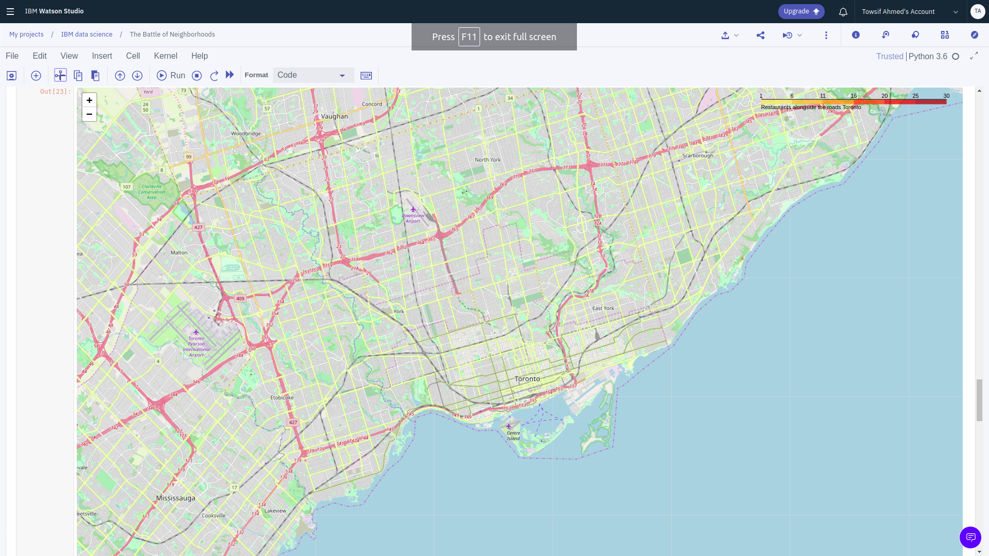
Map of the already placed Restaurants:

Slide 6
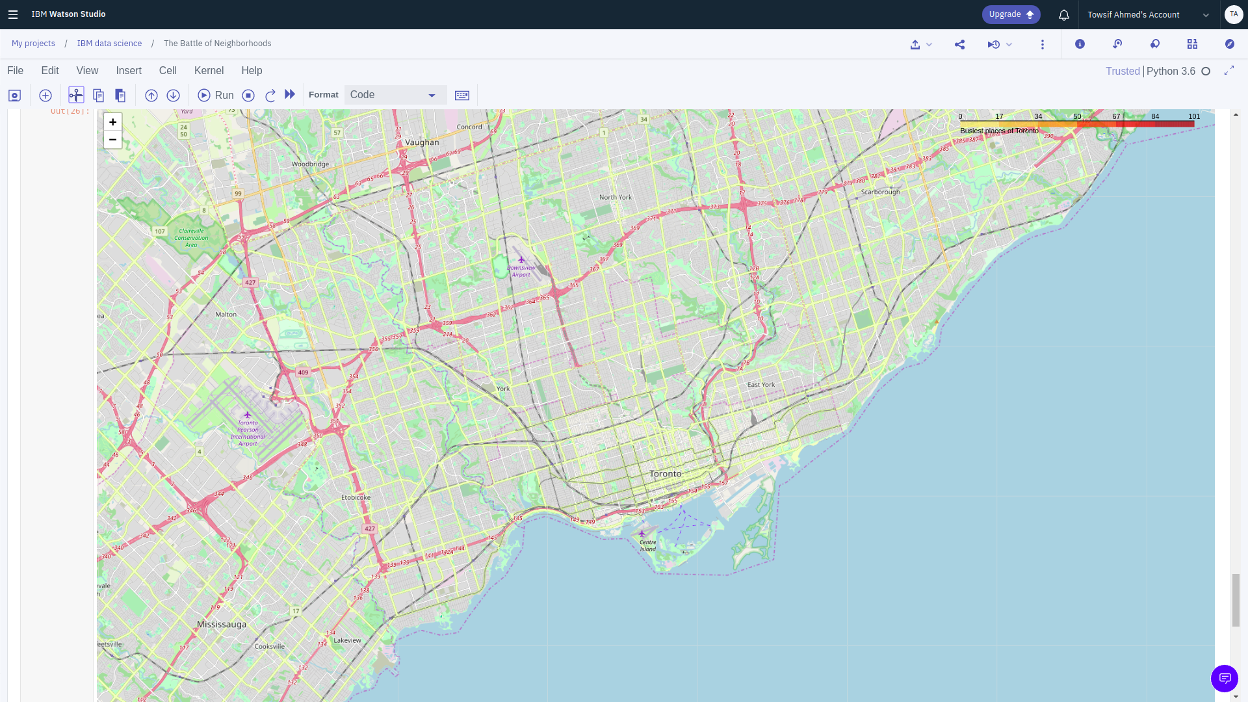
Map of the most busiest places:

Slide 7
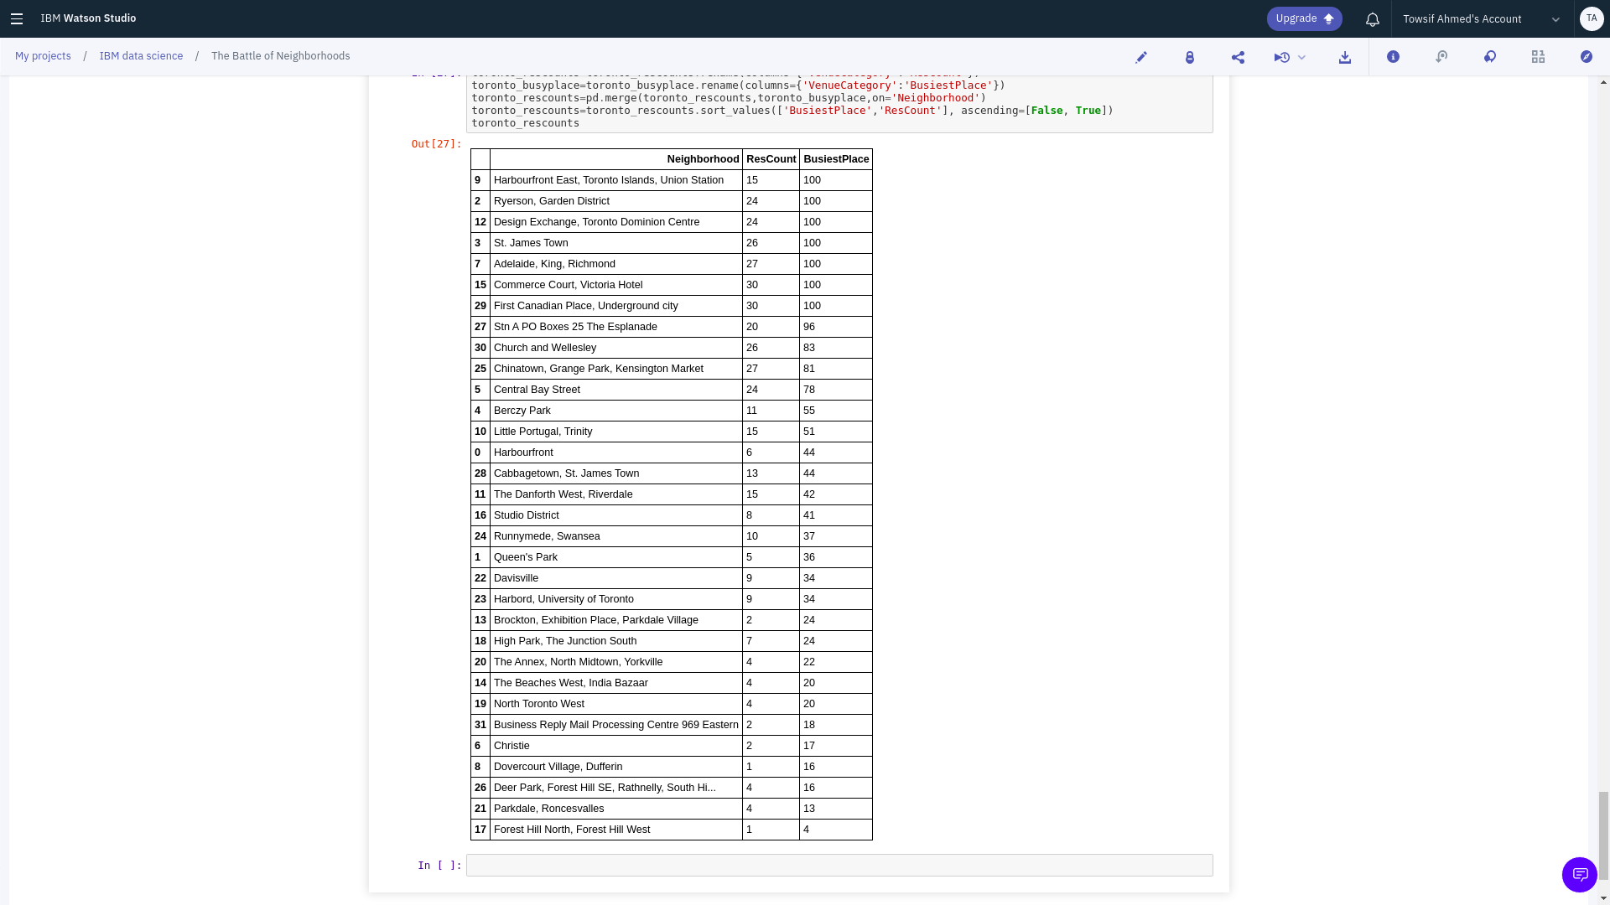
Result Table

Slide 8
Conclusion
Harbourfront East, Toronto Islands, Union Station are the places most suitable to place a restaurant in the city Toronto

Slide 9
Thank You

